Slide 1



Appreciate
Parent Newsletter

Slide 2

About Us
myHappymind is an award winning, NHS backed whole school and nursery curriculum. It teaches children preventative habits that support positive mental health, resilience and self esteem.
Taught to every child in a school from Early Years through to Year 6, myHappymind is delivered via an innovative technology platform making learning easy and fun.
All of the concepts we teach are based in science and research and grounded in Neuroscience and positive psychology.
We are passionate about supporting teacher wellbeing too and so all schools using the programme have access to a teacher wellbeing programme.
We are also proud to support parents by providing them with a free app to continue the learning at home.

Slide 3

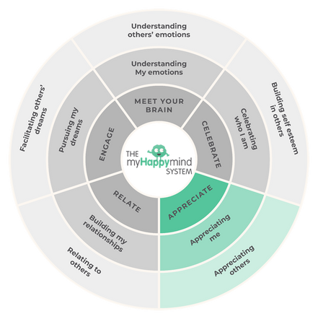
Celebrate
Celebrate
Appreciate
We have just come to the end of the Appreciate module in the myHappymind programme.
We have learnt:
How to develop an Attitude of Gratitude
How to be grateful for others, experiences and ourselves.
How giving and receiving gratitude makes us feel.
2

Slide 4

Appreciate
Why not ask your children to tell you what they have learnt?
Here are some questions to help you:
What have you been grateful for today and how did you show it?
What are the three categories on the Wheel of Gratitude?
How does it make you feel when you give or receive gratitude?
3

Slide 5
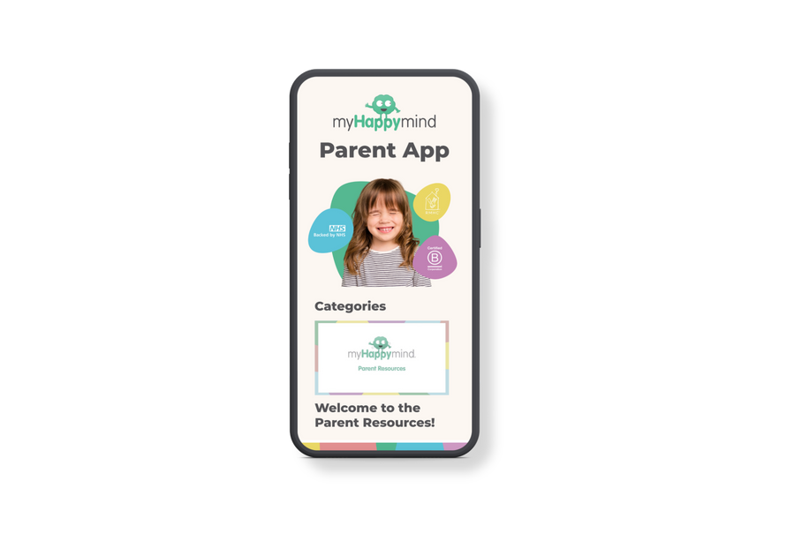
Support your child at home
Log onto the parent app for more information about the Appreciate module and how you can support your child at home.
There are lots of activities you can do together including creating a thankful tree, listening to the story and song, plus much more.
There is a whole Kid’s Zone for your child to enjoy with interactive games. As well as resources for grown-ups too.
myHappymind for Parents
Educate yourself
Learn all about what your children are learning in school
Exclusively for parents with children at a myHappymind School or Nursery.
To access the materials just go to https://myhappymind.org/parent-resources and enter your name, email and authentication code.
(Please contact your school for your authentication code.)
4

Slide 6
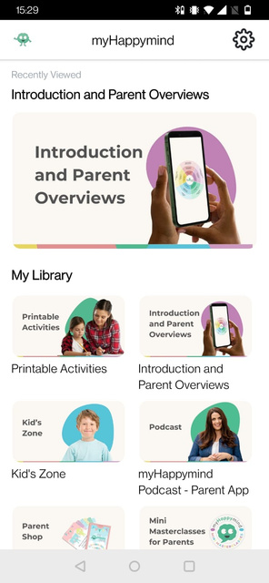
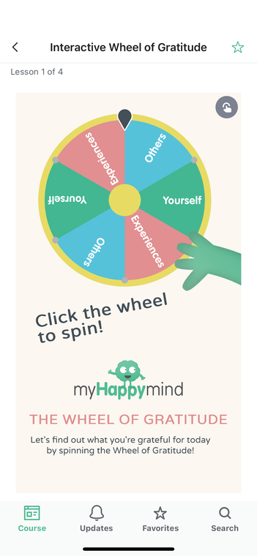
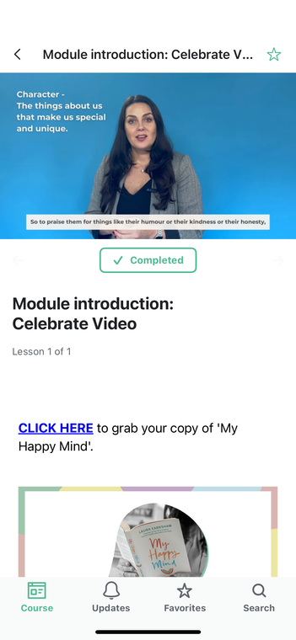


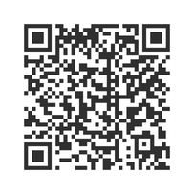
Support your child at home
Download
your FREE
Parent App now!
4

Slide 7
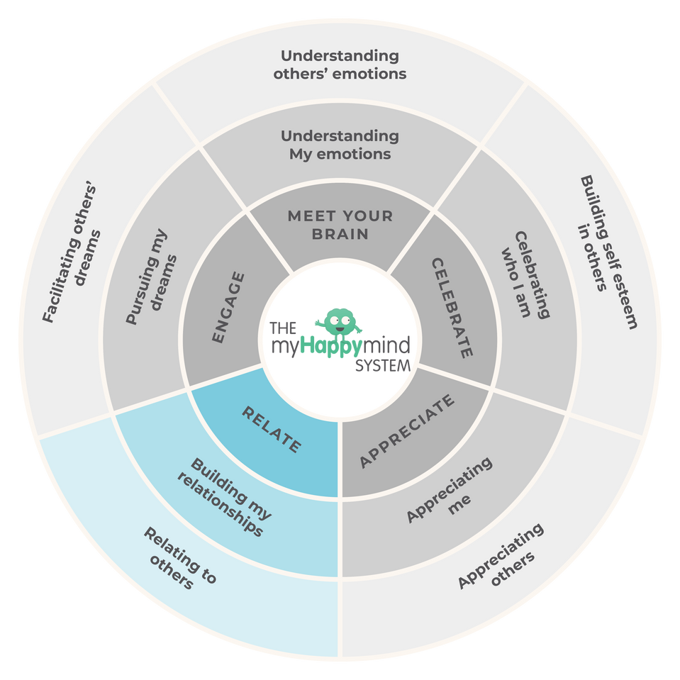
What’s up next...
Relate
Here we will be learning all about how to build positive relationships with others and why relationships are so important to our well-being.
Support your child at home:
You can sign up to the app here:
https://myhappymind.org/parent-resources
(Please contact your school for your authentication code.)
6

Slide 8


Want to learn more
about the science
of happiness?
MY HAPPY MIND
BY LAURA EARNSHAW
My Happy Mind is the first book by our founder Laura Earnshaw. The book reveals all science-backed secrets used in our curriculum to empower ad educate parents - whether your child is struggling already, or you’re interested in future-proofing their mental health, there’s something in here for everyone.
Click here to learn more
7

Slide 9
Appreciate in action
8

Slide 10







Want to hear more
about myHappymind?
Want to share a picture of your myHappymind experience as a parent? We’d love for you to join us over on our social media channels!
myHappymind.org
@myHappymind
@_myHappymind
@myHappymind

