Slide 1
Bewerley Park Year 6 residential 11-14th November 2025

Slide 2
Why a residential visit?
School is able to additionally facilitate the outdoor and adventurous aspects of the PE National Curriculum.
It also helps to support children’s PSHE (personal, social, health and emotion) education. Independence/ Relationships and healthy risk taking.
It also provides hands-on opportunities to explore and understand aspects of the geography curriculum – river location.
Why Bewerley Park?
Experiences developed in half day activities at a fantastic location in Nidderdale.
Experienced staff and activities that can be easily catered and adapted for the different needs of the children.
Opportunities to take part in activities that many children will not have experienced before.

Slide 3
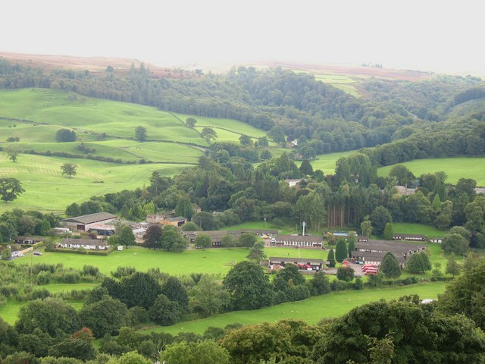
Bewerley Park Location
Bewerley Park is located within an area of outstanding natural beauty in the Yorkshire Dales National Park, Bewerley Park is located 30 minutes from Harrogate and is ideally situated to provide a wide range of activities in stunning natural surroundings.

Slide 4
Bewerley Park Team
The team of outdoor teachers and tutors know the Yorkshire Dales, inside out. Together they have many years of experience, and qualifications in all the activities they deliver.
They understand how to bring out the very best of real outdoor education adventure for all children. St Peters staff will be with each group of children to provide the additional pastoral support and encouragement.

Slide 5
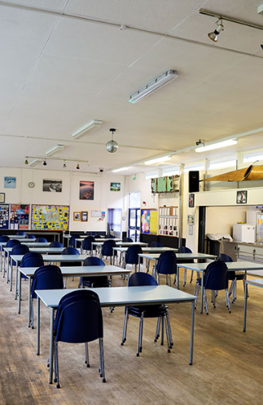
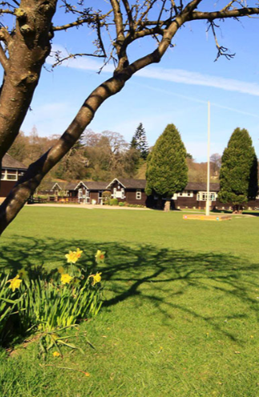
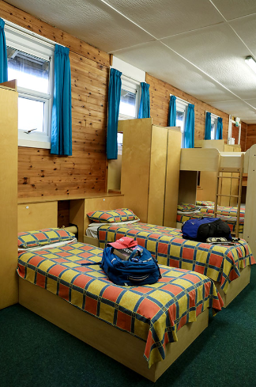
Bewerley Park Venue
The Site is able to offer comfortable accommodation, wholesome food and modern facilities.
The large grounds and meeting rooms provide plenty of opportunity at the end of the day to either relax or get physical outside.

Slide 6
Bewerley Park Facilities
Secure environment with qualified instructors
Bewerley Park office staff on site during the day – experienced instructors with activity groups
Member of Bewerley Park staff on site available 24hrs
Activities both on and off site
Day time activities led by Bewerley Park staff – supported by St Peters staff for pastoral needs
Evening activities led by St Peter’s staff with support from Bewerley Park
Several Dormitories – Boys and Girls are separate
Each dormitory has shower and toilet facilities.
A St Peter’s member of staff is assigned to each dormitory
Food includes
Full Breakfast
Packed lunch and drinks provided daily
Cooked meal each evening
Supper is a drink and snack. Tuck shop is also available!

Slide 7
Bewerley Park equipment
Please do not buy any specialist equipment or new clothing for the residential – old clothes and plenty as most will get wet.
Bewerley Park will provide…..
Waterproof trousers and jacket – to be kept for the duration of the residential
Walking boots and wellies – if not owned (no need to buy specifically for the residential)
Safety equipment such as helmets at the beginning of a specific activity.
Wetsuits (if needed)- at the beginning of the activity.

Slide 8
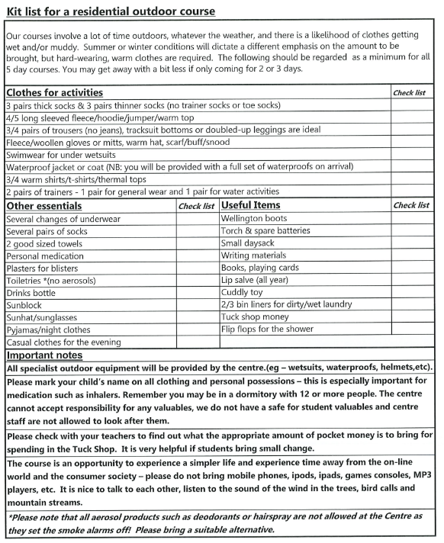
Bewerley Park Kit List
Children will receive a printed copy of the kit list to take home ahead of the trip

Slide 9
Bewerley Park Activities
All activities are taking advantages of the natural river surroundings of Bewerley Park
All activities are subject to change depending on weather; daily discussions will be held between Bewerley Park Leaders and St Peter’s staff.
All activities are planned to make a positive difference to each child’s character, resilience, self-belief and motivation. They have also been designed to develop their wider social, emotions and communication skills as well as help them to build positive, healthy attitudes and a growth mindset.

Slide 10
Possible daytime activities (weather dependent):
River scramble
Canoeing
Mine Exploration
High Ropes (The Leap of Faith)
Brimham Rocks
Possible evening activities:
Nighttime walk
Team building activities and games

Slide 11
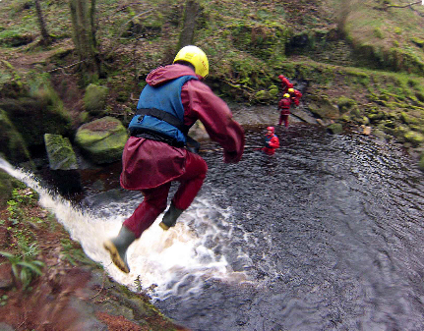
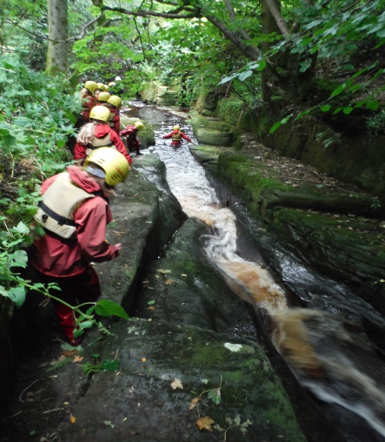
River Scramble
Climb, Squeeze, Slide!
Rock hopping, squeezing though rock tunnels, climbing waterfalls, sliding down rock chutes, and plunging into pools, river scrambling is all about working together as a team to navigate this adventurous terrain.
Apart from being a lot of fun, children will learn to assess challenges, make safe choices, and help each other to ensure everyone is supported through each challenge.

Slide 12
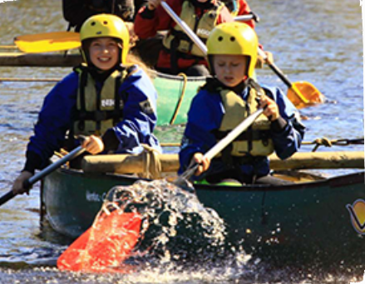
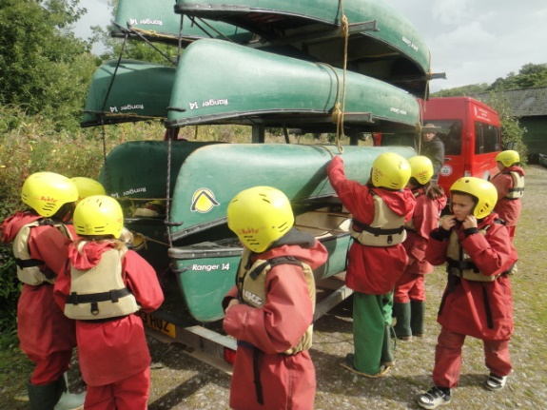
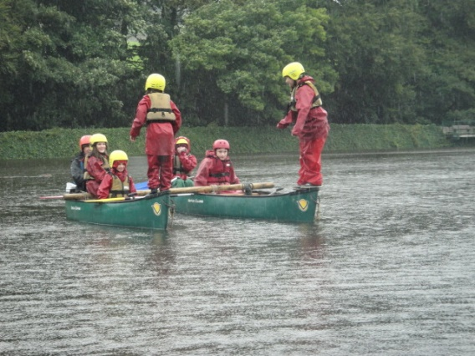
Canoeing
Canoeing from river to Whitby harbour!
Canoes are stable, versatile and fun. Children will need to communicate with their friends in the canoe so they are all paddling to the same plan!
Together we will head off for an exciting journey of discovery (with a few really fun games thrown in along the way!).

Slide 13
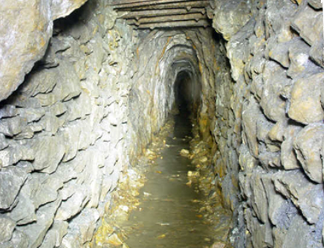
Mine Exploration
Lights on, let’s go!
A journey into a mine is a journey back in time!
Guided by headlights to lead the way, children will work closely together to navigate passages and tunnels, first dug in 1782, to discover preserved mine workings and get a glimpse of the life of a lead miner.
Children will be able to discover gems and rock formation.

Slide 14
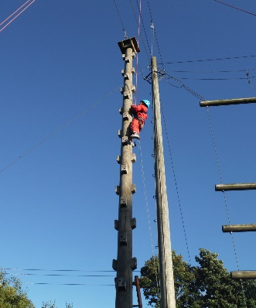
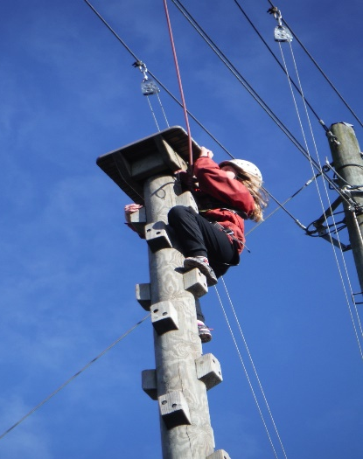
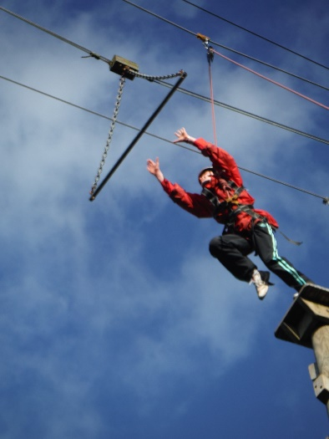
High Ropes
Leap of Faith
Take a leap of faith and learn how to keep yourself and your friends safe whilst having fun!
Tackled alone but as part of a team, children will learn to manage risk, cooperate, and support each other in a series of high ropes challenges that are sure to get the heart rate pumping.
The level of difficulty of challenges is adapted to the age and level of experience of students on adventure.

Slide 15
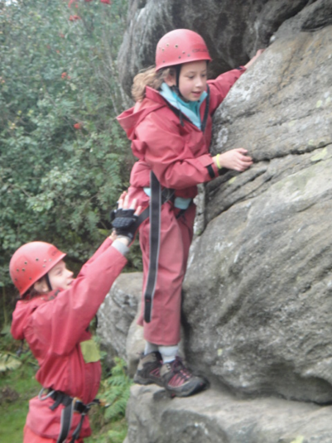
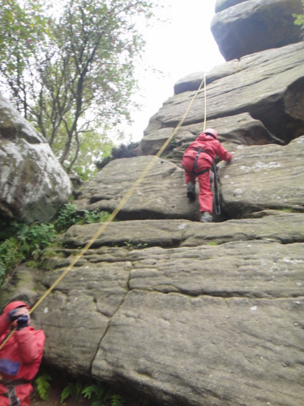
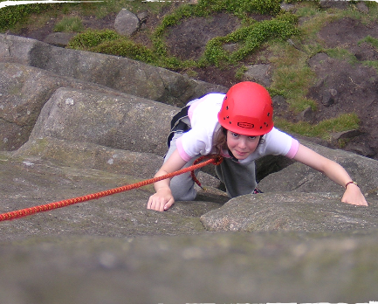
Brimham Rocks
Reach for the Top! This is a great activity for all abilities and a great way to develop confidence. It takes determination, trust, and the help of others to get to the top – building confidence and gaining an enormous sense of achievement.
It will also be used to introduce, extend and review personal and team skills of: Communication, Confidence, Perseverance

Slide 16
Getting in Touch
If your child has any additional requirements that school may not be aware of, such as night-time only medication, please get in touch either by phone or send an email to admin@stpeters.ycst.co.uk so that these needs can be planned for and met. All children will be asked who they would like to be in a dormitory and activity group with before the trip. Due to the logistics of the site, we can only guarantee that they will definitely be with one friend. If you have any questions about the residential, please do not hesitate to get in touch with either Mrs Henderson, Mrs Williams or Mr Griffiths.

