Slide 1
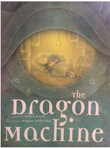
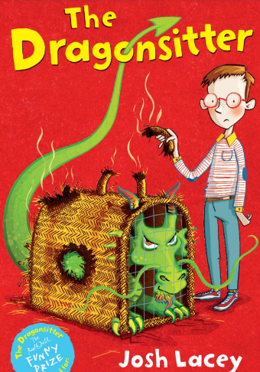
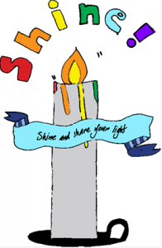
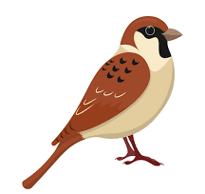
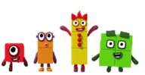
English
This term with Miss Potter our key texts will be The Dragon Machine’ by Helen Ward and ‘My name is not Refugee’ beverydayyMise. We will also be reading two class books over the course of the term. These are ‘The Dragonsitter’ by Josh Lacey and ‘A Bear Called Paddington’ by Michael Bond. In Spring 1, our writing focus will be to write a story based on The Dragon Machine with a change of character or setting. In Spring 2, We will be writing a recount based on the events of ‘My Name is not Refugee.
This term with Miss Corrigan our key texts will be ‘Grandpa’s Gift' by Fiona Lumbers and ‘Beegu’ by Alexis Deacon. Our witing focus for Spring 1 will be to a story about a character who finds magic in every day things. In Spring 2, our witing focus will be to write a story based on the book with a new lost creature.
Phonics and Spelling
Children in Year 2 undertake a 30 minute phonics or spelling session every day. All the children are starting the spring ter by going ove the bridge to spelling units that weren’t secure in Autumn. They will then have an assessment before they move onto Little Wandle Spelling- a unit that will prepare the children for their spelling in KS2.
Children Year 1 will all undertake a 30 minute phonics session every day. The children will learn new sounds, with the opportunity to re-visit and put their learning into practise throughout the week.
Children in Year 1 will continue to learn new phase 5 GPC’s as well as continuing to revisit and review previously learnt graphemes
Our vision is simple. We want everyone to SHINE.
‘Do not light a lamp and cover it with a bowl or put it under the bed. Instead they put it on a lampstand, so that people will see the light as they come in’. Luke 8 v16
Sparrows and Finches Curriculum Learning Overview – Spring 2025
Mathematics
This term in Year 2, your child will be learning to:
Represent counting 2’s, 10’s and 5’s as their equivalent times tables.
Multiply by 2 using doubling and halving with a focus on factors and products.
Understand division structures.
Discuss and compare 2D and 3D shapes.
Add and subtract 2, two digit numbers.
This term in Year 1, your child will be learning to:
Count, recognise and compare numbers 0-10.
Count to and from 20.
Count in tens.
Recognise patterns in counting 20-100.
Compare quantities using part-part whole models.
Learn the composition of numbers 0-5.
Recognise and manipulate 2D and 3D shapes.
Mastering Number
We also participate in a scheme from the NCETM called ‘Mastering Number’. The aim of this scheme is that over time, children will leave Key Stage 1 with fluency in calculations, a confidence and a flexibility with number.
The focus over the course of the year will be subitising, cardinality, ordinality, counting, composition, comparison and number facts.
Enrichment Opportunities: Mobile Planetarium, Harrogate Spring Walk, Easter Service, Dentist Visit, Teddy Bears Picnic.
Religious Education
In RE, our big questions this half term are:
Who is Jewish and how do they live?
What makes some places special to believers?
What do Christians believe God is like?
Why does Easter matter to Christians?

Slide 2
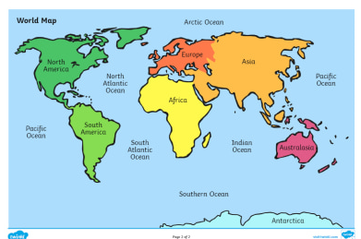
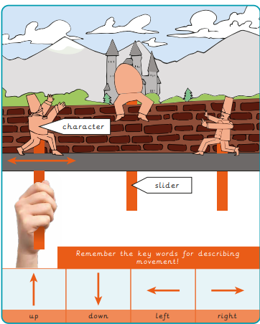
PE
The children will enjoy 2 PE sessions within the week. Please ensure your child comes to school wearing their PE kit on these days. Weather dependent the children will have their PE sessions both in and outdoors. Where possible, towards the end of the Spring term, we will endeavour to get to the stray. The PE sessions follow a scheme called REAL PE. This scheme real PE gives every child the physical literacy, emotional and thinking skills to achieve in PE, Sport and life. The unique, child centred approach transforms how we teach PE to include, challenge and support every child.
There will be a focus on 2 skills over the next term:
The focus will be on both dynamic and static balance. The children will use equipment to support their progression of both. The children will also be doing Real Gym where they will be learning about developing a sequence of movements using apparatus.
History In History this term The Great Fire of London, how it started and the impact it had. We will also be learning about Neil Armstrong and the great space race and considering the question: Were the explorers oof the past discoverers or invaders?
Geography In Geography we will be thinking about the UK and London, This will involve locating and identifying countries and capital cities of the UK including London.
Art
In Spring, Year 1 and 2 will be learning about Digital Media in the art lessons, with a focus on Piet Mondrian. The children will know that
Mondrian is an abstract painting artist who used squares and rectangles in his work, that the primary colours are red, yellow and blue and that digital media is any form of media (art, music, photographs) created on a machine. The children will learn how to create straight lines and fill shapes using PowerPoint, how to open PowerPoint and explore the tools to draw e.g. shapes, straight lines, drawing tool, how to create shapes and lines of different lengths and thicknesses to create their own digital media version of a Mondrian piece and how to use squares and rectangles and the primary colours taken as inspiration from Mondrian’s work
. DT
This term in DT the children will be learning about mechanisms and will ultimately strive to create a moving book. They will be exploring slider mechanisms and the movement they output to design, make and evaluate a moving storybook.
Music
The children enjoy their Music sessions every other week. The unit the children will be learning about this term is:
Comparing Dynamics: Theme Space. The Children will develop knowledge and understanding of dynamics using instruments; learning to compose and play rhythms to represent planets.
Science
This term, the children will be learning about two different areas of science; The Earths rotation in Space and Seasonal Changes.
Children will be able to
To know what space is, what the universe is and what planets are in our solar system.
To know that at the centre of our solar system is a star called the sun and that all planets in our solar system orbit it.
To know that it takes the earth 365 days to orbit the sun and that it rotates once on its axis in 24 hours.
Recognise seasonal changes in Spring focussing on temperature, weather and day length and a comparison with what they know about Autumn and Winter.
PSHE
This term, children will be asked the question and given the opportunity to reflect upon:
What helps us to stay healthy? With a particular focus on dental hygiene.
What is money and how can it be spent?

Slide 3
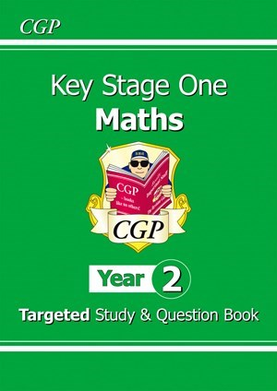
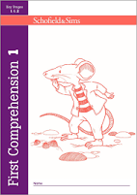
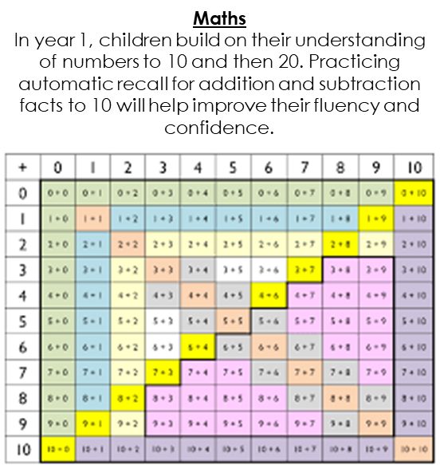
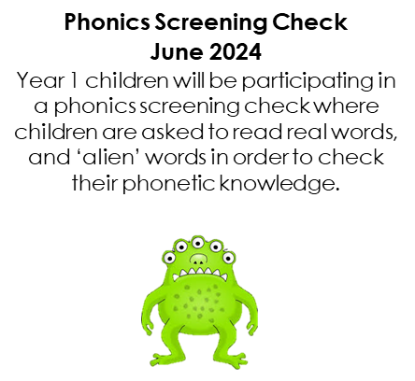
Phonics and Spelling
Maths books and Reading Comprehension. This term, children in year 2 will be continuing with a Maths workbook and a Reading Comprehension book every Friday, to be returned to school by Wednesday so that they can be marked. Tasks will be set weekly and the page to be completed will be highlighted. There will often be an optional extra page to do in the maths workbook which will also be marked if completed. We really appreciate all of your support in helping your child to complete both the maths activity and the reading comprehension activity every week.
Year 1 and 2 Expectations
Children in Year 1 and 2 are given; 1 reading book and 1 sharing story per week. Whilst in school, children read as a group on 3 separate occasions. When your child is fully secure (based on the Little Wandle reading assessments), your child will move onto banded reading books and will be read with at least once a week. At this point, their reading records will be checked daily, and they can change their books when required.
It is important that at home you are reading with your child as often as you can. This may be listening to them read their decodable book or be sharing a story together. Anytime you read together at home we would love to know about it, so please let us know about it in your child’s reading record.
Your child will be sent home with spellings to practice on a Friday for a test the following Friday. These spellings will be based on their phonics and spelling sessions they receive daily in school. Please practice the spellings with your child as frequently as possible to ensure confidence when it comes to the test at the end of the week.
How you can help support your child’s learning.

