Slide 1
Our Vision
Shine in the light and love of God.
LOVE, LEARN, SHINE
“The light shines in the darkness and the darkness has never put it out”
(John 1.5)

Slide 2
Jesus said ‘I am the light of the world.’
‘Help us love, help us learn, help us light up our world.’
‘We welcome everyone to our worship time today.’

Slide 3
Our Worship Theme
Generosity

Slide 4
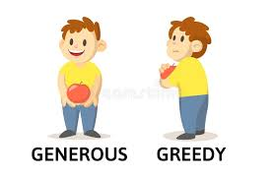
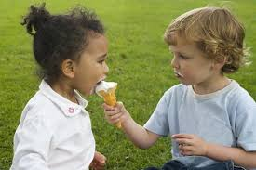
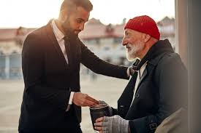
Generosity – Key Words
Generous –
give or to share unselfishly
Unselfish – concerned for others more than self
Willingness to give generously
Can add specific additional words relevant to class discussions.
Give – share with others voluntarily without expecting anything in return

Slide 5
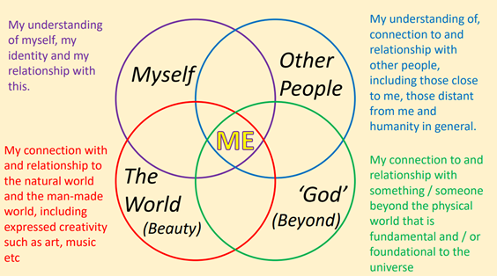
Spirituality

Slide 6
Spirituality
Spirituality is not something we can see; it is something we feel inside ourselves. For us it is about, asking, thinking about and reflecting on big* questions and being aware of something ‘bigger’ outside of ourselves. It is about the relationship we have with ourselves, others, the physical world, and the world beyond the physical. Spiritual experiences or moments shape and deepen our understanding of ourselves and helps us make sense of all around us and be at peace.

Slide 7
Big Question
Is it belter to have a friend or be a friend?
How many friends do you need?
What is a Big Question?
A question is a question that prompts deep thinking and discussion of belief, ideas and understanding. The purpose is to elicit thought and discussion rather than a particular final answer.

Slide 8
Window – Looking Out.
What could be improved?
Mirror – Reflecting.
How has it made me feel?
Have my thoughts or feelings changed?
Door – A new opportunity.
What might I do now?

Slide 9
Our Reflections.
Class………..
Record class reflections here….
Window – Looking Out.
What could be improved?
Mirror – Reflecting.
How has it made me feel?
Have my thoughts or feelings changed?
Door – A new opportunity.
What might I do now?

Slide 10
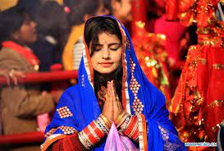
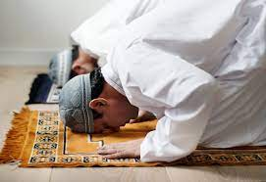
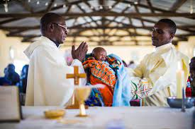
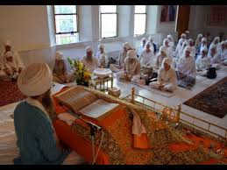
Prayer & Reflection
Prayer is a special time when people talk to their God.
For me it is a quiet and peaceful time.
I am going to say a prayer now. If you would like to you can join me in saying Amen at the end.

Slide 11
‘Jesus loves and cares for everyone.
Peace and love be with you.’
‘And also with you.’
‘Go in peace to share and shine your light.’

