Slide 1
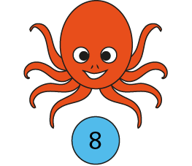
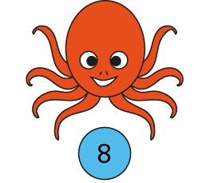
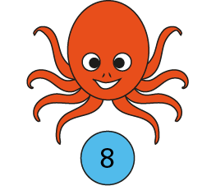
Friday 10th March 2023 10.03.23
Learning Objective: To know my multiples of 8.
How many tentacles? Count in groups of 8.
0
8
16
24
There are 24 tentacles.
3 × 8 = 24
8 × 3 = 24
Notes:
There are three groups of eight; there are eight, three times.
There are twenty-four altogether.
Three is a factor. Eight is a factor.
The product of three and eight is twenty-four.
Twenty-four is the product of three and eight.

Slide 2
Friday 10th March 2023 10.03.23
Learning Objective: To know my multiples of 8.
How many legs?
5 × 8 =
40
8 × 5 =
40
Notes:
Complete the equations to show how many legs altogether.

Slide 3
Friday 10th March 2023 10.03.23
Learning Objective: To know my multiples of 8.
How many legs?
6
× 8 =
48
8 ×
6
=
48
Notes:
Complete the equations to show how many legs altogether.

Slide 4
Friday 10th March 2023 10.03.23
Learning Objective: To know my multiples of 8.
How many legs?
7
×
8
=
56
8
×
7
=
56
Notes:
Complete the equations to show how many legs altogether.

Slide 5
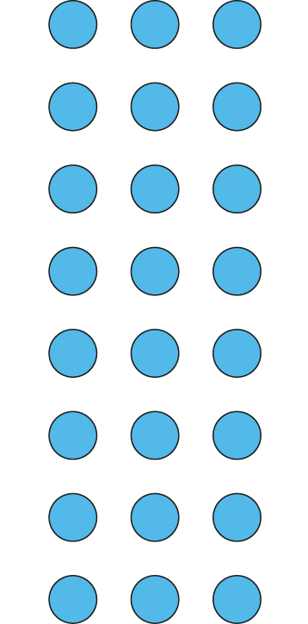
Friday 10th March 2023 10.03.23
Learning Objective: To know my multiples of 8.
Circle the groups of 8.
Circle the 8 equal groups.
8 ×
3
=
24
3
× 8 =
24
There are groups of 8.
3
3
There are 8 groups of .

Slide 6
Friday 10th March 2023 10.03.23
Learning Objective: To know my multiples of 8.
Can you create your own way of showing multiples of 8?
You could use cereals, pieces of pasta, or create groups of 8 footprints in the snow.
If you like, you could use some sticks to make spiders in the snow!
Make sure you say each times table fact both ways round:
8 X 2 = 16 SO 2 X 8 = 16
Have fun!

Slide 7
Friday 10th March 2023 10.03.23
Learning Objective: To know my multiples of 8.

