Slide 1
Science Week 13th – 24th March
Connections

Slide 2
The theme of Science Week this year is ‘Connections’.
What does that word mean?
Why do you think it is important to think about?

Slide 3
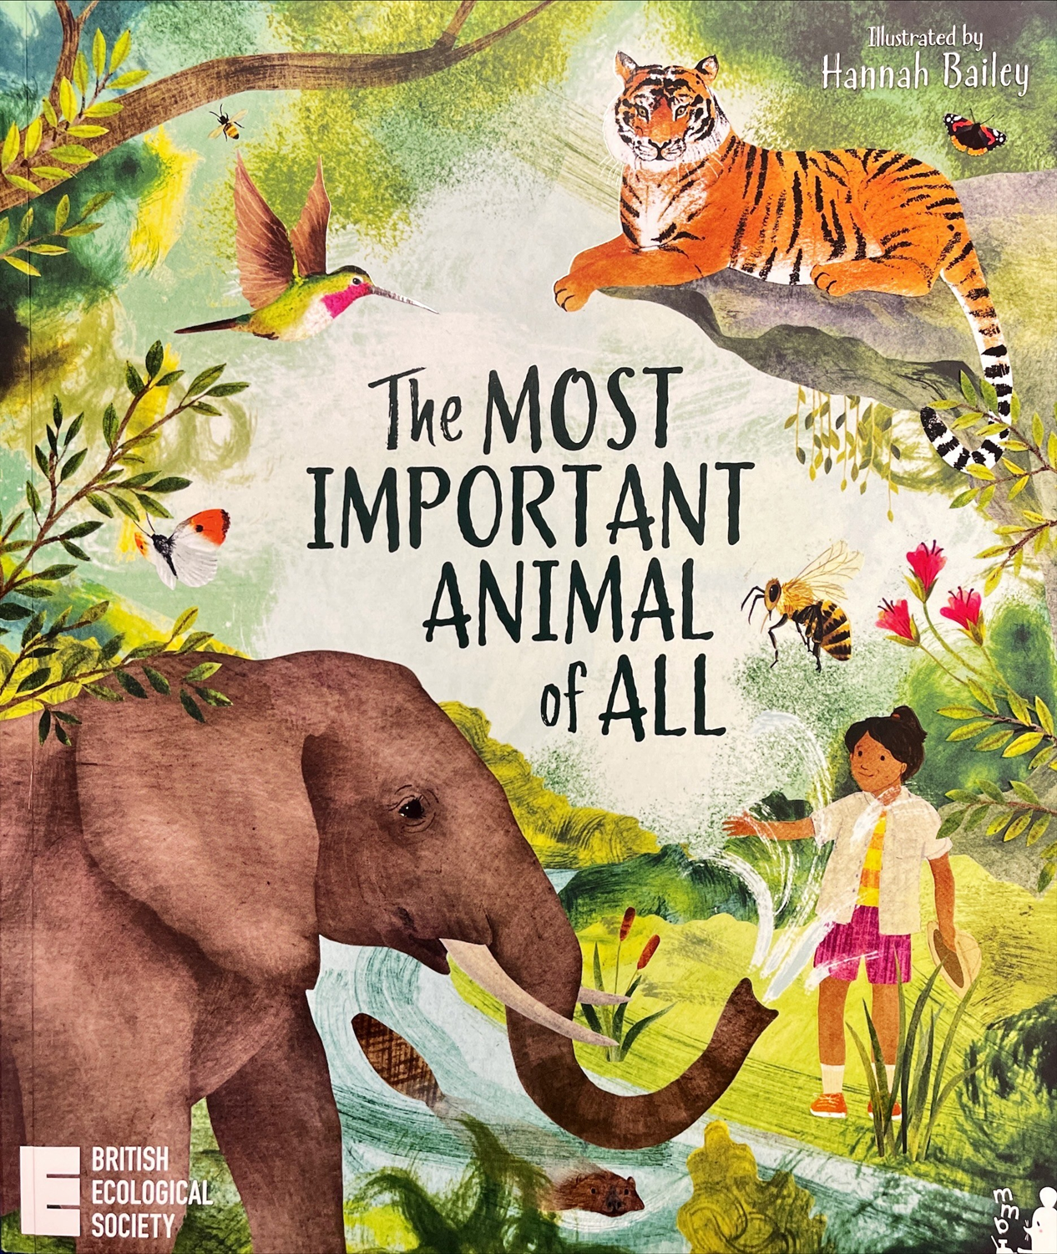
We are going to begin by reading the first few pages of a book called, ‘The Most Important Animal of All’.
Have a think about these things before we read it…
What animals can you think of?
Do you have a favourite animal? Why is that your favourite?
Which animal do you think will come out as the ‘most important’ from the book?

Slide 5
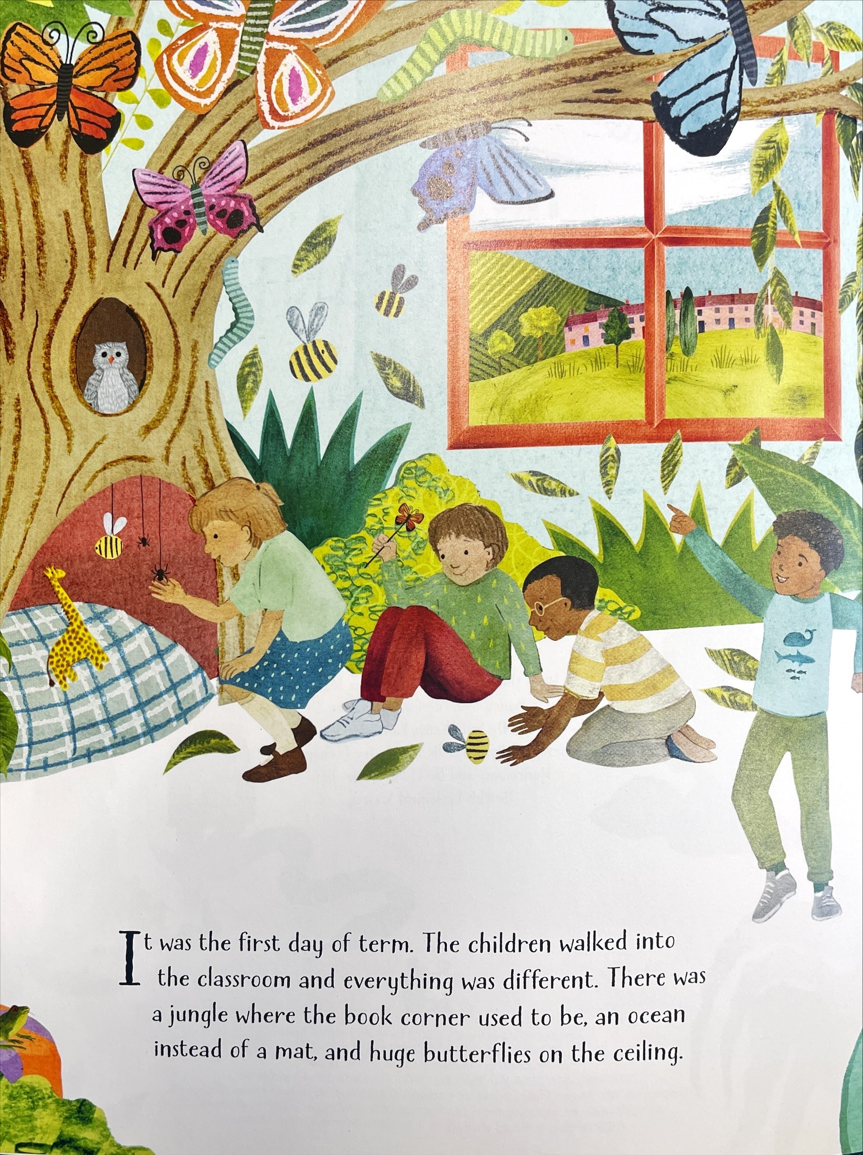

Slide 6
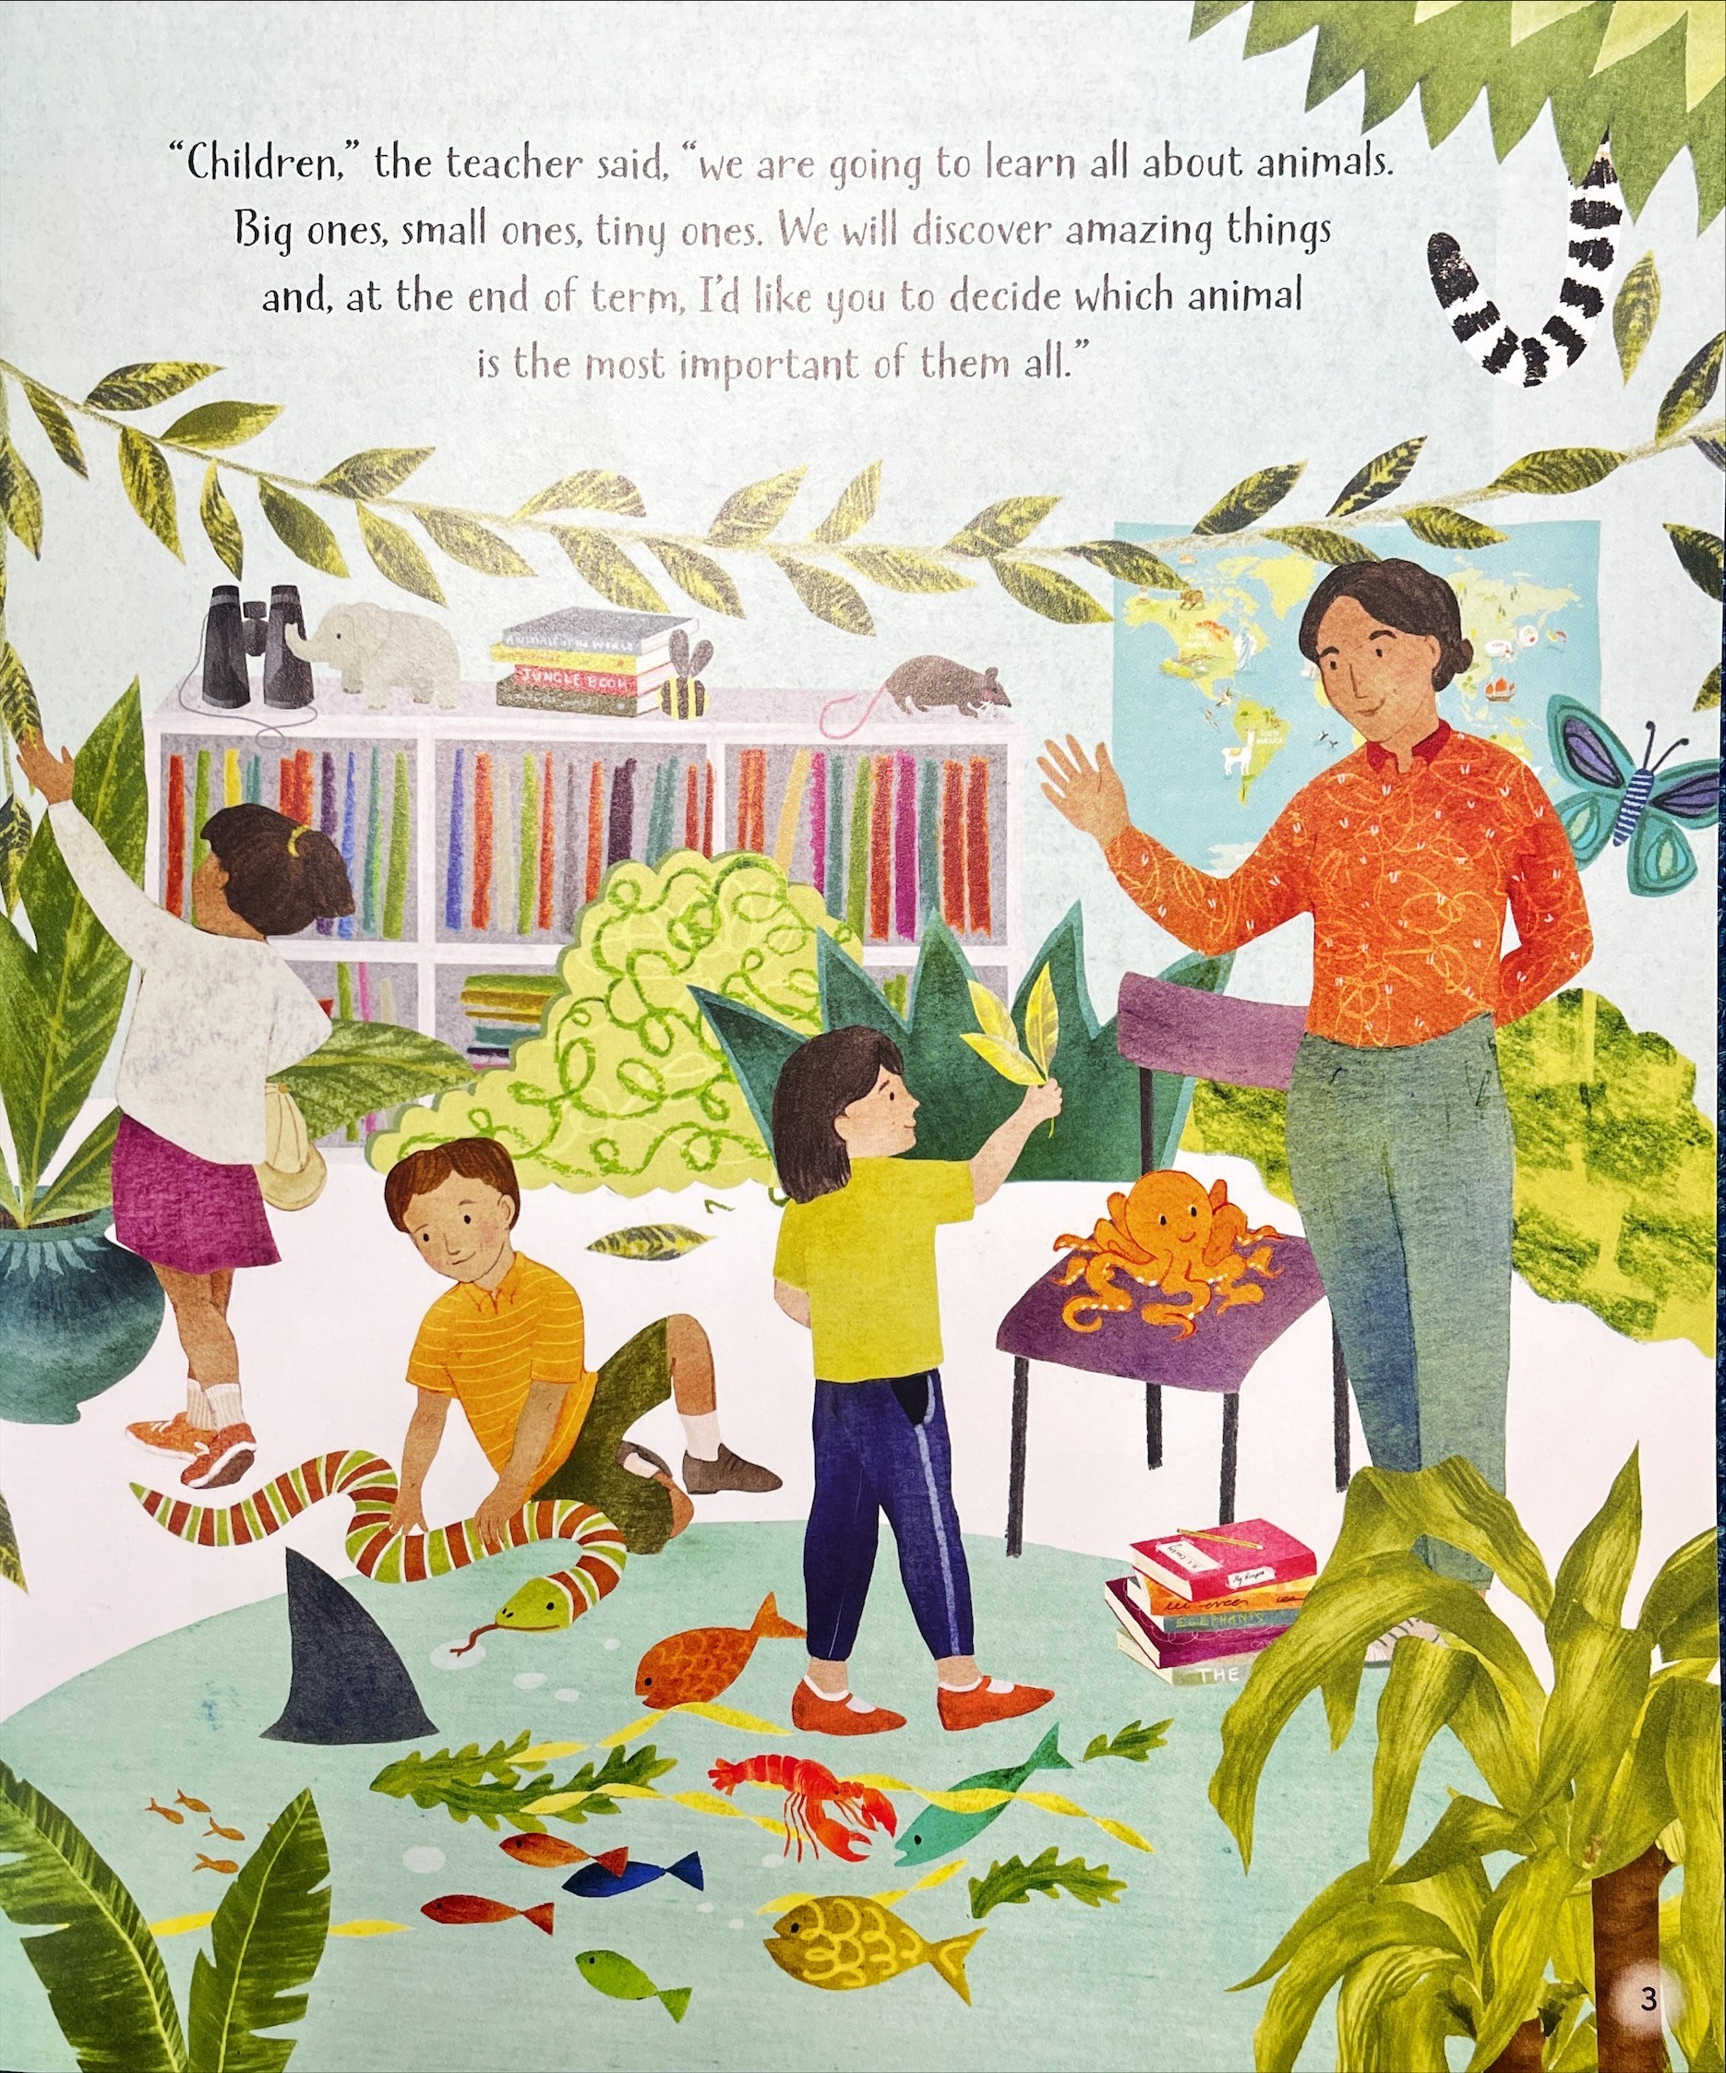

Slide 7
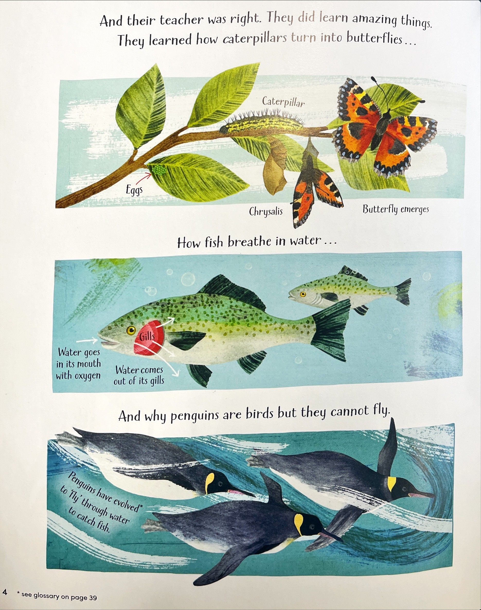

Slide 8
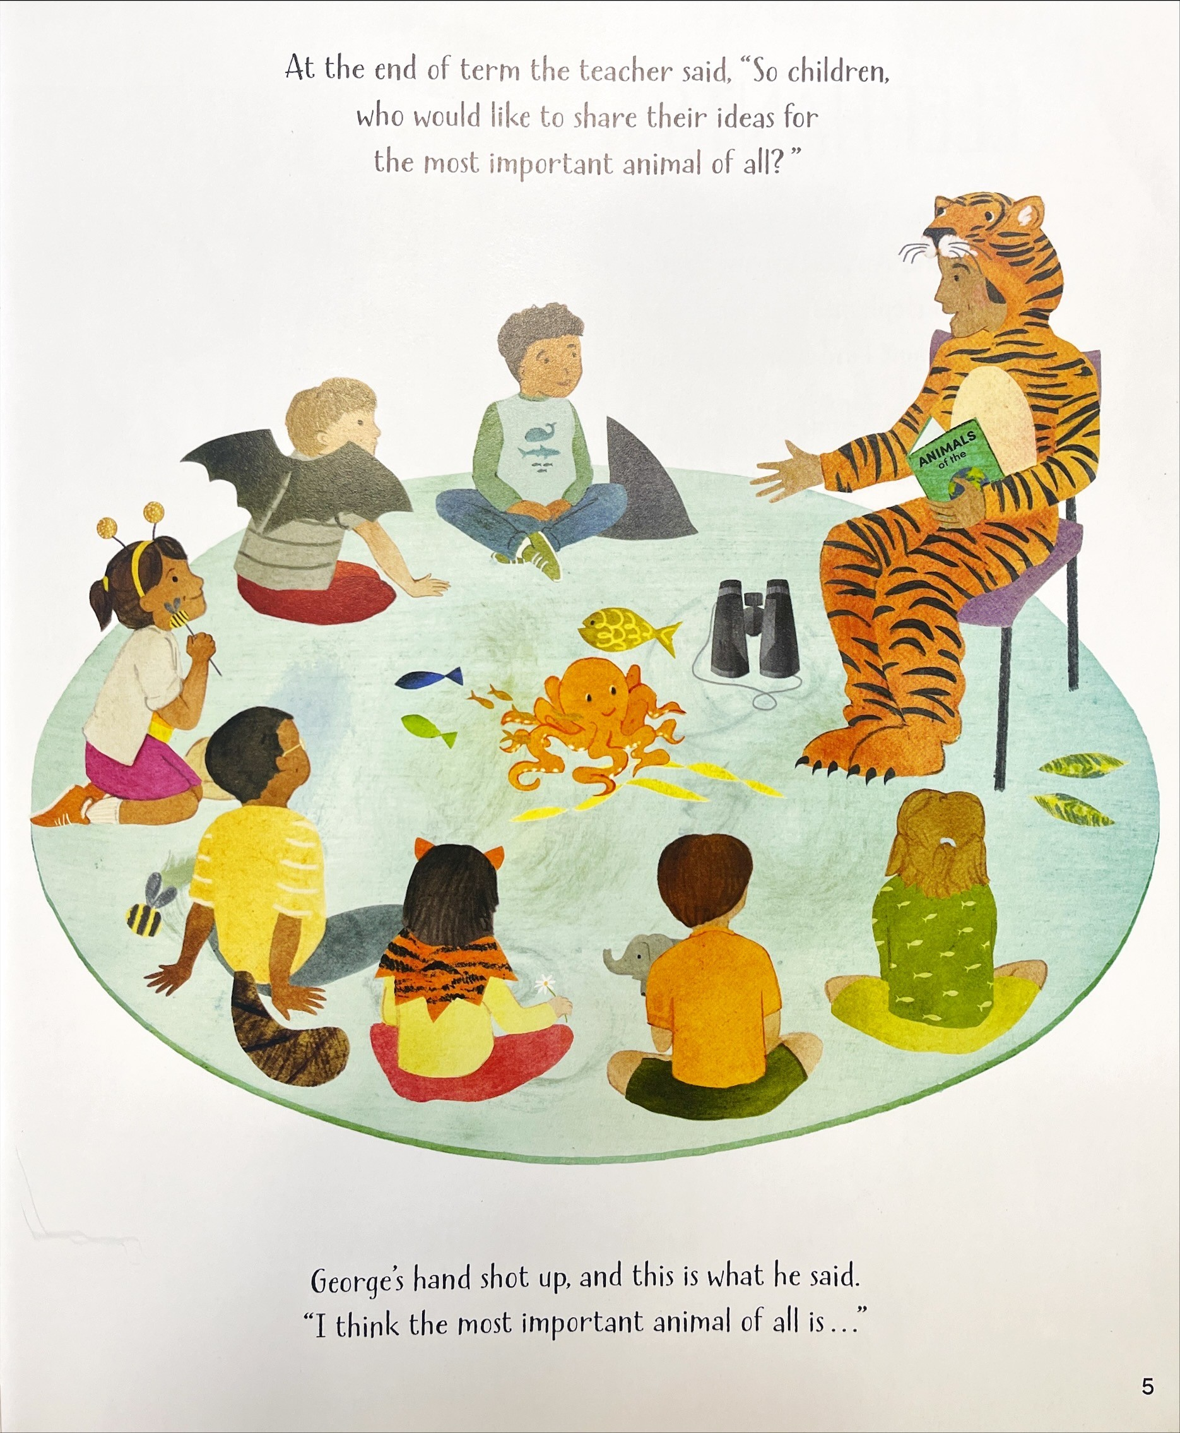

Slide 9
Each class will have an animal to research.
It is your job as a class to convince the whole school that your animal is the most important.
You could do this by looking into:
Their habitat
Fun facts
Ecosystems they support
Their endangered status and why they need protecting
Food chains they are part of
And many more things!
Are you up for the challenge and ready to find out which animal you have?

Slide 10
The classes and their animals
Drum roll please…
Wrens- Elephant
Kingfishers- Tiger
Sparrows- Shark
Finches- Beaver
Owls- Bee
Starlings- Sea Otter
Ravens- Krill
Herons- Wolf Eagles- Bat

Slide 11
Over the next 2 weeks, please research your animal and come up with some findings and present them however you wish! It might be as simple as a class list, a colourful poster etc.
We will come together on the last week before Easter to read the rest of the story, convince the school and decide who has the most important animal of all.
I wonder which class will be the most convincing…

