Slide 1
Talk to your partners and discuss.

Slide 2
Which of our units have been physics based?

Slide 4
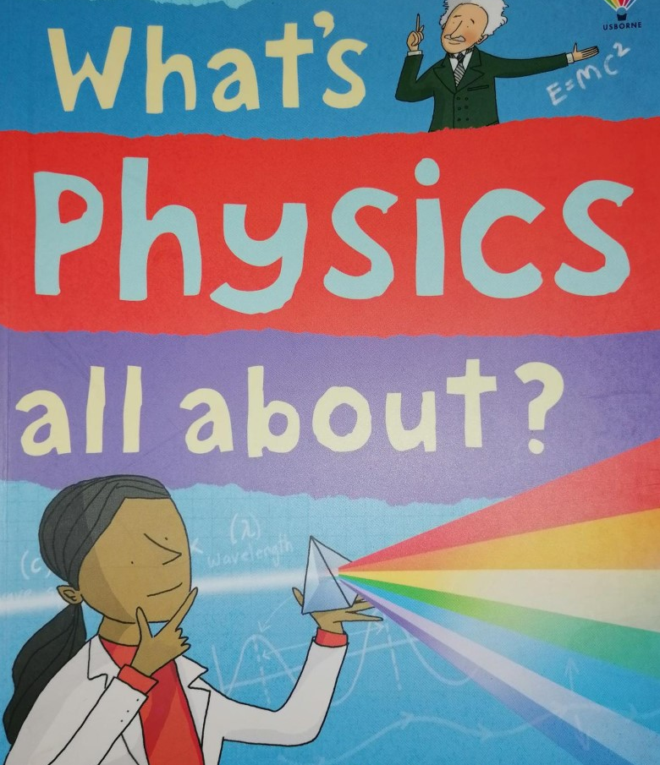
Poster competition
*Create a poster showcasing what physics is.
*Ideas-
Use drawings
Use examples of real life physics
Use examples of careers linked to physics
Use key words
You will have an A4 poster to create for the competition.
There will be prizes for each year group!

